Slide 1
Visualizing Concepts with a
Domain
Model

Slide 2
Overview
A Domain Model visualizes noteworthy concepts or objects in the domain.
You will be able to:
  Read and write the UML class diagram notation for a Domain Model
  Create a Domain Model
  Apply guidelines
  Relate it to other artifacts
use cases sys. sequence diagrams domain models operation contract

Slide 3
DEFINITION & MOTIVATION: Domain Model
A Domain Model visualizes, using UML class diagram notation, noteworthy concepts or objects.
  It is a kind of “visual dictionary.”
  Not a picture of software classes.
It helps us identify, relate and visualize important information.
It provides inspiration for later creation of software design classes, to reduce “representational gap.”
use cases sys. sequence diagrams domain models operation contract

Slide 4
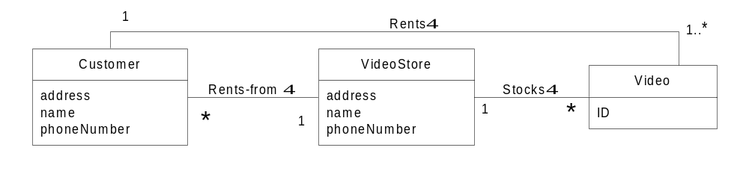
EXAMPLE: Partial Domain Model
use cases sys. sequence diagrams domain models operation contract

Slide 5

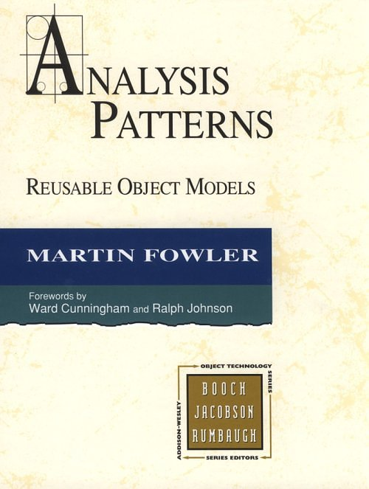
GUIDELINES: Finding Domain Concepts
Candidate lists (see text, p. 134)
“Abbott” Analysis; AKA Linguistic Analysis
  Most simply, “pick out the nouns”
Existing analysis patterns:
use cases sys. sequence diagrams domain models operation contract

Slide 6
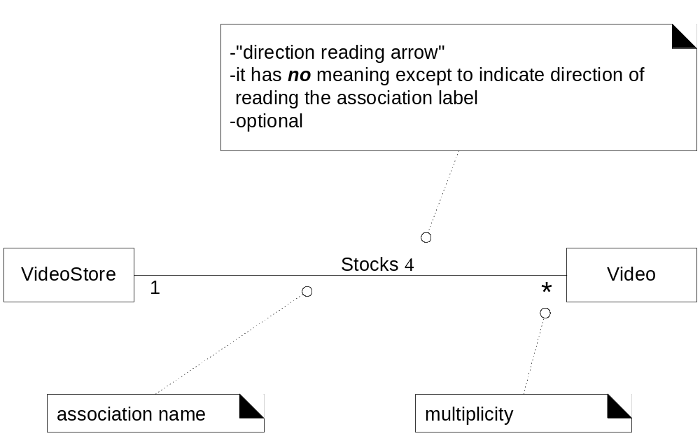
UML: Associations
use cases sys. sequence diagrams domain models operation contract

Slide 7
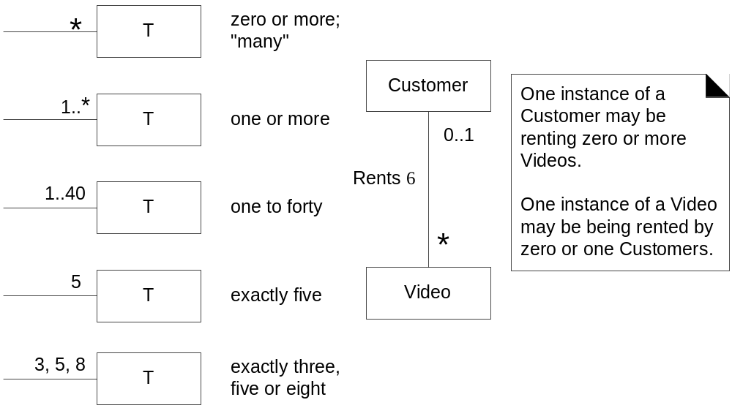
UML: Multiplicity
use cases sys. sequence diagrams domain models operation contract

Slide 8
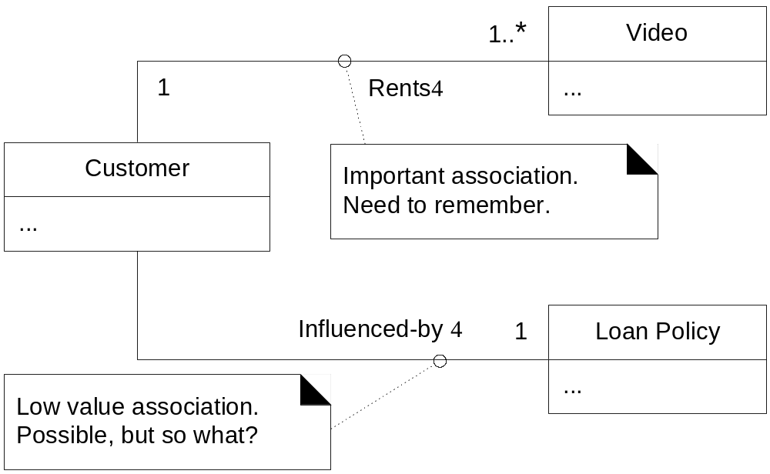
GUIDELINES: Associations
Only add associations for noteworthy relationships. Literally, those for which making a “note” is worthy or business motivated.
use cases sys. sequence diagrams domain models operation contract

Slide 9
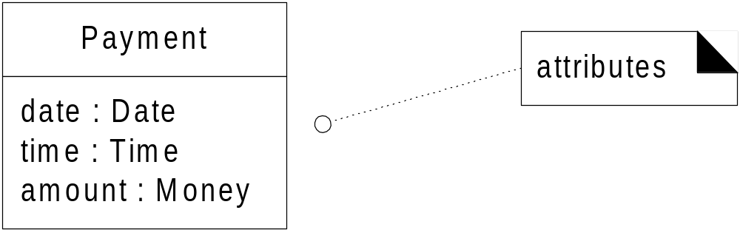
UML and GUIDELINES: Attributes
Show only “simple” relatively primitive types as attributes.
Connections to other concepts are to be represented as associations, not attributes.
use cases sys. sequence diagrams domain models operation contract

Slide 10
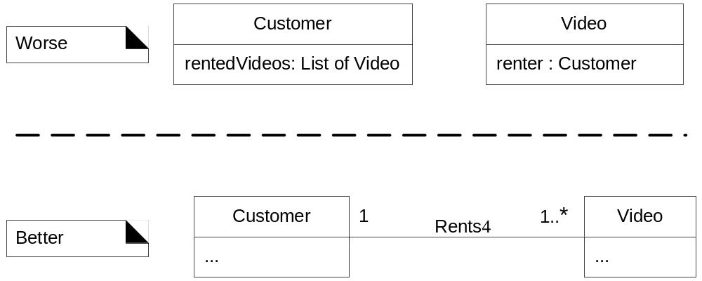
GUIDELINES: Attributes
Why??
use cases sys. sequence diagrams domain models operation contract

Slide 11
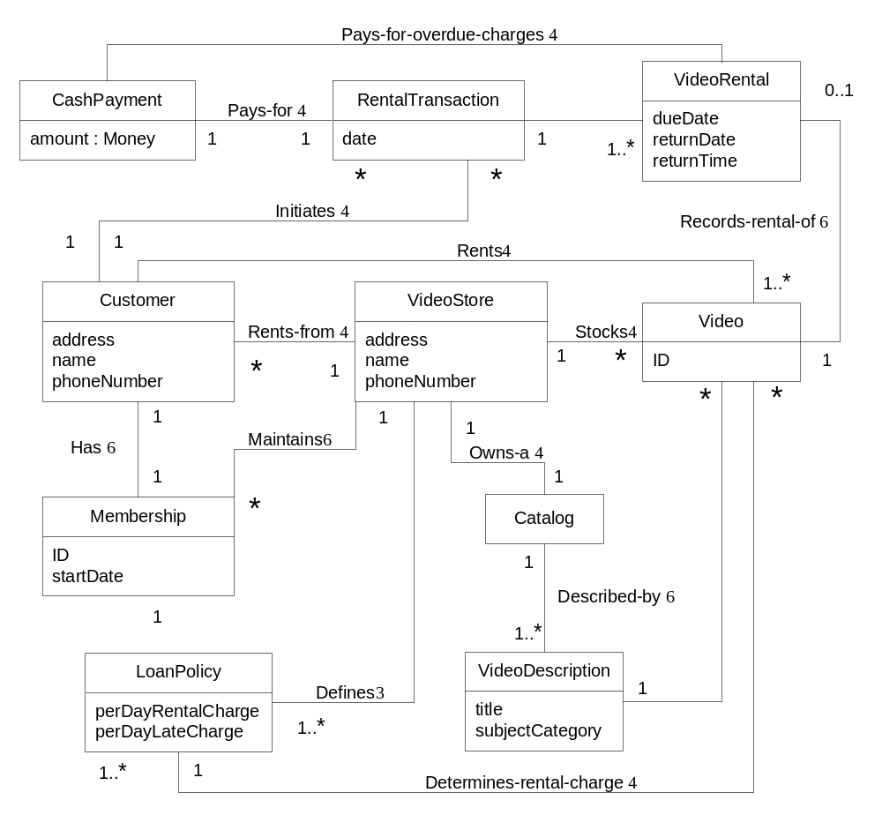

EXAMPLE: Domain Model
Notice how this can be viewed as a “visual dictionary.” It illustrates concepts, words, things in a domain.
use cases sys. sequence diagrams domain models operation contract

Slide 12
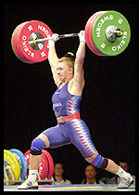


In small teams at the whiteboard, draw a partial Domain Model, limited to the Main Success Scenario of the Process Sale use case, and assuming iteration 1 simplifications.
  Use the text’s use case as the basis. p. 50
  Apply the guidelines
use cases sys. sequence diagrams domain models operation contract

Slide 13
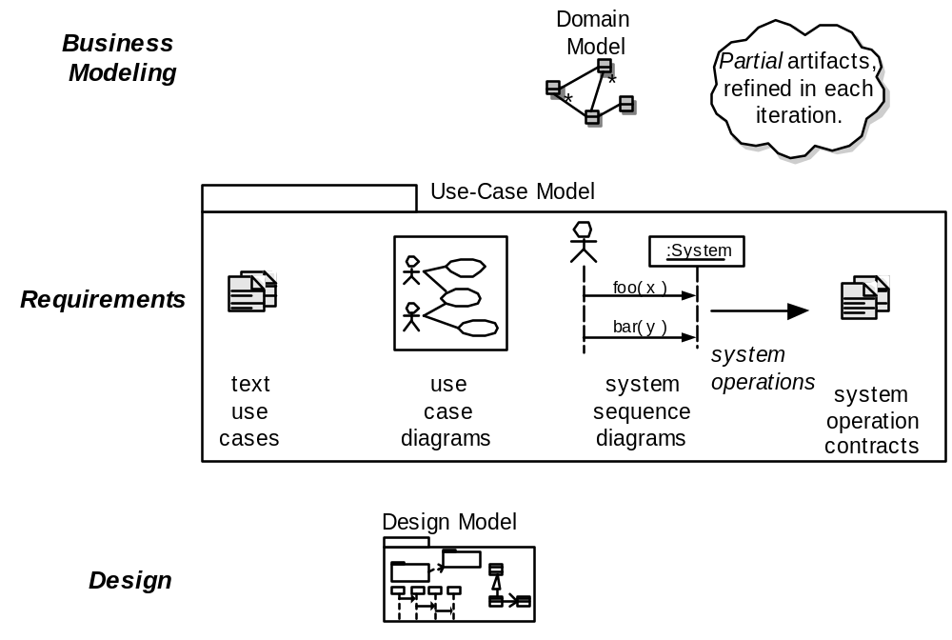
Artifacts in the UP Use-Case Model
use cases sys. sequence diagrams domain models operation contract

Slide 14
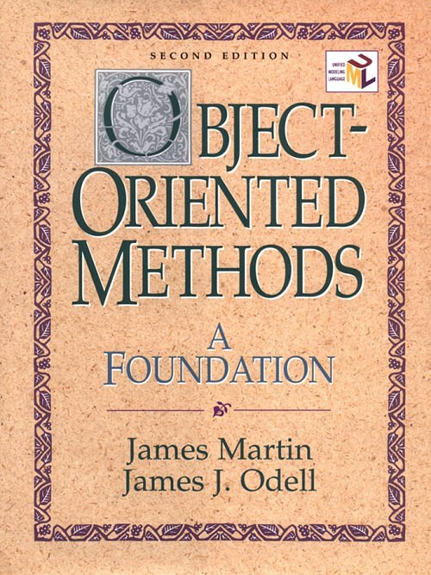
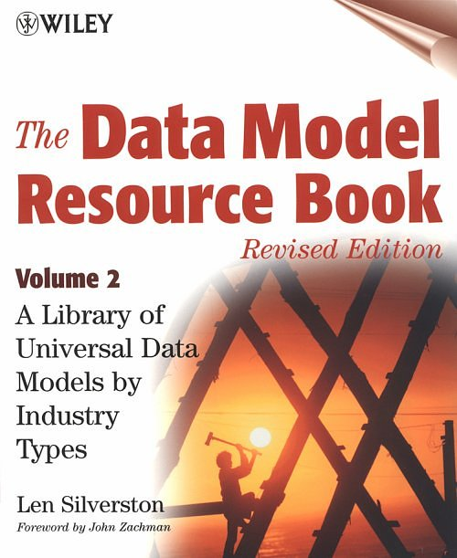
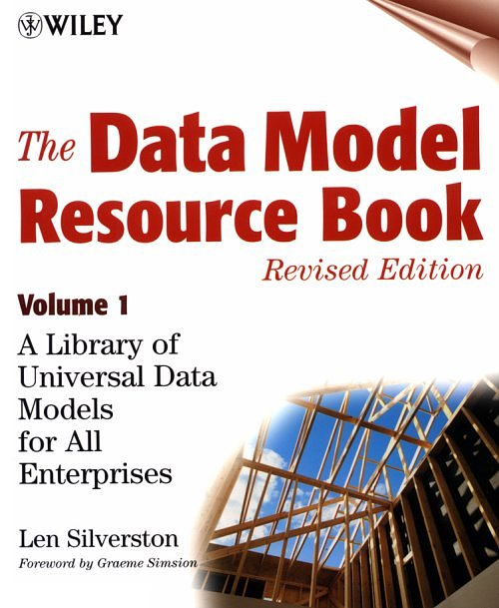
Recommended Resources
use cases sys. sequence diagrams domain models operation contract

Slide 15
Without notes, draw all UP disciplines and artifacts discussed, and relate them.
use cases sys. sequence diagrams domain models operation contract

Slide 16
Objectives assessment. Can you:
  Read and write the UML class diagram notation for a Domain Model
  Create a Domain Model
  Apply guidelines
  Relate it to other artifacts
use cases sys. sequence diagrams domain models operation contract

